Slide 1

GIT & GITHUB
Basics of Distributed Version Control
(some slides courtesy of Pro Git)
Charles Liu

Slide 2
Overview
What is Git? Installation and setup
Introduction to version control; basic workflow in Git
Branching, merging, and rebasing
Working with remotes and Github

Slide 3
What is Git?
◻◻ A distributed version control system
◻◻ A few use cases:
¤ Keep a history of previous versions
¤ Develop simultaneously on different branches
 Easily try out new features, integrate them into production or throw them out
¤ Collaborate with other developers
 “Push” and “pull” code from hosted repositories such as Github

Slide 4
Key improvements
◻◻ A distributed version control system
¤ Everyone can act as the “server”
¤ Everyone mirrors the entire repository instead of simply checking out the latest version of the code (unlike svn)
◻◻ Many local operations
¤ Cheap to create new branches, merge, etc.
¤ Speed increases over non-distributed systems like svn

Slide 5
Installation and setup
◻◻ http://git-scm.com/download (try this first)
◻◻ Linux: apt-get install git-core
◻◻ Mac: http://code.google.com/p/git-osx-installer/
◻◻ Windows: http://msysgit.github.com/
¤ Git bash
◻◻ Eclipse extensions such as eGit
◻◻ Github GUI

Slide 6
First time setup
◻◻ git config --global user.name “Charles Liu”
◻◻ git config --global user.email “cliu2014@mit.edu”
¤ This email should be registered in your Github (more on this later)
◻◻ Line breaks (\r\n in Windows vs. \n in Mac/Linux)
¤ Mac/Linux: git config --global core.autocrlf input
¤ Windows: git config --global core.autocrlf true

Slide 7

Use case #1: history of versions
 Basic workflow
 Adding and committing files
 The git log
 The staging area
 Removing files
 Viewing diffs of files
 The .gitignore file

Slide 8
Big ideas
◻◻ Snapshots, not deltas
◻◻ Everything is confined to the .git directory
◻◻ Most operations are safe – they only add data
¤ We’ll talk about two commands that are not safe today
◻◻ 3 possible states for a file
¤ Changed
¤ Staged
¤ Committed

Slide 9
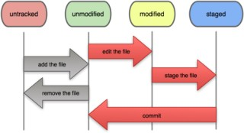
Basic workflow
◻◻ git init – create git project in existing directory
¤ Make Git start to “watch” for changes in the directory
◻◻ The basic workflow:

Slide 10
Basic workflow
◻◻ Add files to be committed with git add <filename>
¤ Puts the file in the “staging area”
◻◻ Create a commit (a “snapshot”) of added files with
git commit, followed by a commit message
◻◻ Use git status to see the current status of your working tree

Slide 11
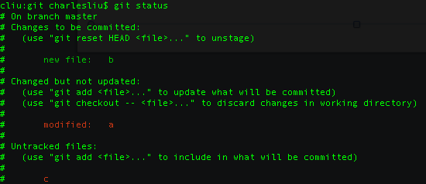
The git status output

Slide 12
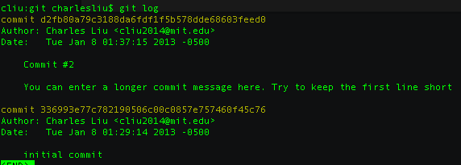
The git log output

Slide 13
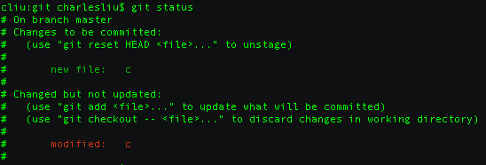
The staging area
◻◻ git add takes the snapshot of the file that will be committed →→ you can change the file after adding it

Slide 14
The staging area
◻◻ To unstage a file, but retain your changes in the working tree:
¤ git reset HEAD <filename>
◻◻ To discard current changes in the working tree, and make it look like the last commit:
¤ git checkout -- <filename>
¤ Be careful! You will lose your changes and not get them back!

Slide 15
Removing a file
◻◻ To remove a file from the working tree and in the next commit, simply git rm <filename>
◻◻ To remove it from the next commit, but keep the file in the working tree, do git rm --cached <filename>

Slide 16
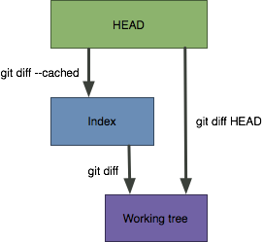
Viewing diffs of files

Slide 17
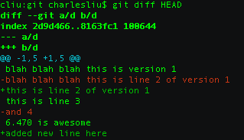
Viewing diffs of files

Slide 18
The .gitignore file
◻◻ Specifies files that you don’t want Git to track under version control
◻◻ Commonly used for compiled files, binaries, large asset files (e.g. images)
◻◻ Can use wildcards (e.g. *.pyc, *.png, Images/*, etc.)
◻◻ Be careful – if you add a file to .gitignore after it’s already been tracked, potential issues
◻◻ A list of recommended .gitignore files: https://github.com/github/gitignore

Slide 19
Use case #2: branching
 What is a branch?
 Branching commands
 The HEAD pointer
 Basics of merging
 Basics of rebasing
 Aside: the git reset command

Slide 20
What is a branch?
◻◻ Visualize a project’s development as a “linked list” of commits.
◻◻ When a development track splits, a new branch is created.
◻◻ In Git, branches are actually just a pointer to these commits

Slide 21
Branching commands
◻◻ List all branches in the project – git branch
◻◻ Create a new branch – git branch <branchname>
◻◻ Switch to a branch – git checkout <branchname>
◻◻ Create and immediately switch – git checkout –b
<branchname>
◻◻ Delete a branch – git branch –d <branchname>

Slide 22
Stashing
◻◻ Working tree must be clean when switching branches
◻◻ Stash changes that you don’t want to commit at that time – git stash
¤ Puts a stash onto the stack
◻◻ Later, apply the most recent stashed changes and remove that stash – git stash pop

Slide 23
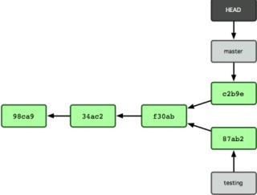
The HEAD pointer
◻◻ Recall: all branches simply a pointer to a commit
◻◻ HEAD: special pointer to the current branch, moves around as you switch branches

Slide 24
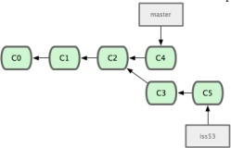
Merging

Slide 25


Merging
HEAD
1. git checkout master

Slide 26

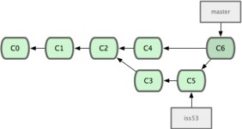

Merging
HEAD
git checkout master
git merge iss53

Slide 27
Merging
HEAD
git checkout master
git merge iss53
Note: merge creates a new commit with 2 parents!

Slide 28
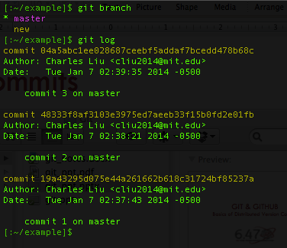
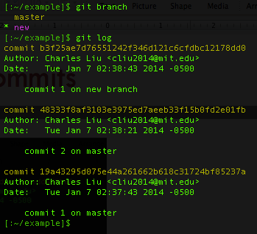
Merge commits
Before merge…master and new have diverged (commit 3 on master vs. commit 1 on new branch)

Slide 29
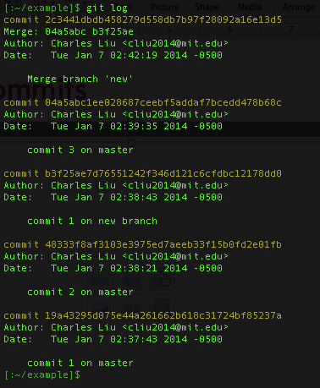


Merge commits
Old tip of master
Old tip of new branch

Slide 30

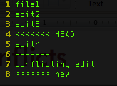
Merge conflicts
◻◻ Sometimes, two branches will edit the same piece of code in different ways.
◻◻ Must resolve the conflict manually, then add the conflicting files and explicitly commit.
Conflict markers

Slide 31
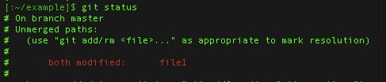
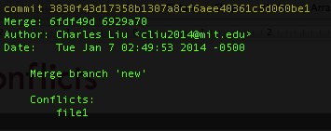
Merge conflicts

Slide 32
Rebasing
◻◻ Instead of a merge, which creates a new commit originating from both branches, a rebase takes the contents of one branch after the “split” and moves them to the end of the other branch.
◻◻ The command git rebase <basebranch> takes your currently checked out branch and replays the diffs on top of basebranch.

Slide 33
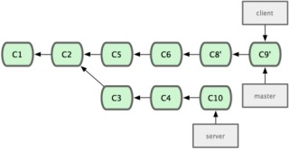


Rebasing
1. git checkout server
HEAD

Slide 34
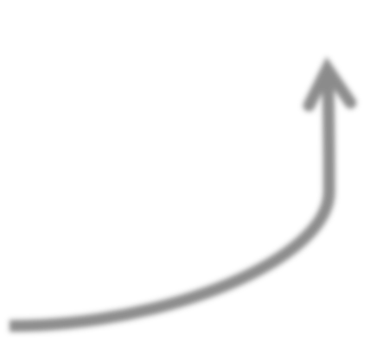

Rebasing
git checkout server
git rebase master
HEAD

Slide 35

Rebasing
git checkout server
git rebase master

Slide 36
Why rebase?
◻◻ Creates a linear history; often cleaner and easier to read.
◻◻ But…DO. NOT. EVER. rebase anything that has already been pushed to a repo someone else has access to
¤ Rebasing removes commits and writes new ones; but someone else might have already based their work off your old commits!

Slide 37
An aside…the git reset command
◻◻ 3 versions…and often the source of much confusion!
¤ git reset --soft <commit / pointer to commit>
¤ git reset --mixed <commit / pointer to commit> (or simply git reset)
¤ git reset --hard <commit / pointer to commit>
◻◻ Reset proceeds in 3 steps:
Move the HEAD pointer
Update the index/staging area to the new contents of HEAD
Update the working directory

Slide 38
3 steps to reset
Move the HEAD pointer – soft stops here.
Update the index/staging area to the new contents of HEAD – mixed stops here.
Update the working directory – hard stops here
Note: reset --hard overwrites the working directory. This is another command that can potentially cause loss of data!

Slide 39
Use case #3: collaboration
 Creating a repo on Github
 Remotes
 Remote-tracking branches
 Push, fetch, and pull
 The git clone command

Slide 40
Remotes
◻◻ A target computer that has Git repos that you can access
¤ Via http(s), ssh, or git protocols
◻◻ git remote add <remotename> <remoteaddress>
◻◻ git remote –v (view remotes)
◻◻ git remote rm <remotename>
◻◻ Often, with one remote, we name it “origin”

Slide 41
Authenticating to Github
◻◻ Sometimes recommends HTTPS, but often SSH easier
◻◻ Need to generate a keypair: https://help.github.com/articles/generating-ssh- keys

Slide 42
Github – SSH keys
◻◻ cd ~/.ssh; ls
◻◻ If a file named id_dsa.pub or id_rsa.pub does not exist:
¤ ssh-keygen -t dsa -C “<your email here>”
¤ ssh-add id_dsa
◻◻ pbcopy < ~/.ssh/id_dsa.pub (on Macs)

Slide 43

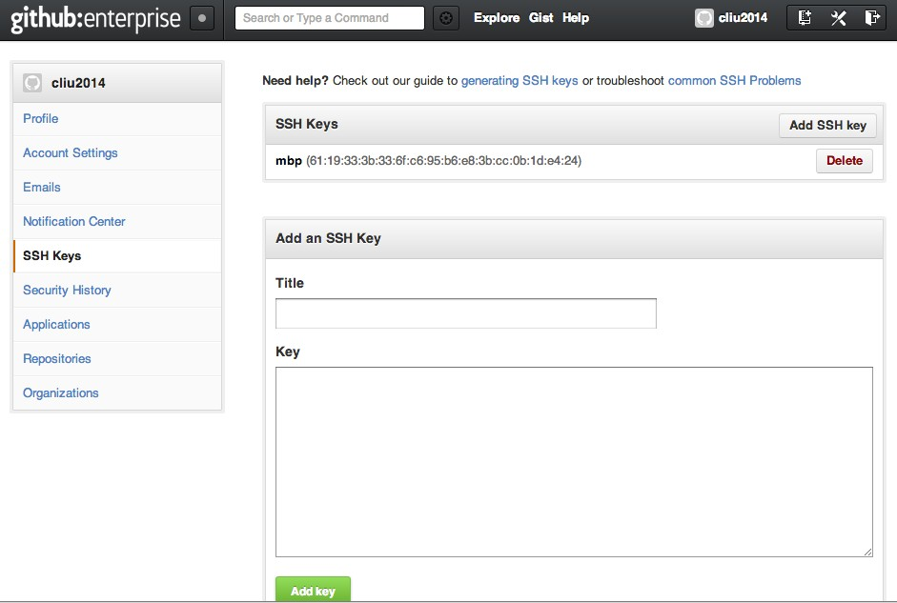


Github – SSH keys
1. Click “account settings”
3. Click “Add SSH key”
2. Click “SSH Keys”
4. Paste your key here

Slide 44
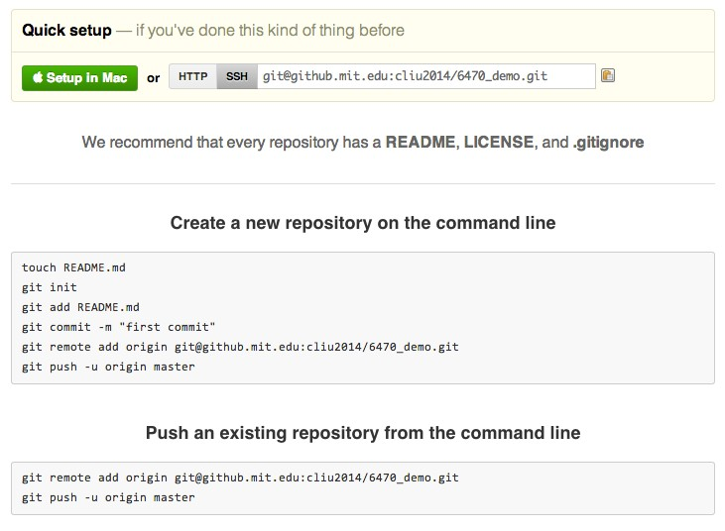

Create a repo
Repo URL

Slide 45
Pushing and fetching
◻◻ git push <remotename> <branchname> sends your code in the branch up to the remote
¤ Often just git push: depends on settings but often equivalent to git push origin master
◻◻ git fetch <remotename>

Slide 46
Remote tracking branches
◻◻ When you do git fetch, you don’t immediately see the changes. Why?
◻◻ Changes are fetched to a “remote tracking branch”
¤ Branches associated with a remote, but treat them like a local branch
¤ Can merge with your current master (git checkout master; git merge origin/master)
¤ Even better…rebase

Slide 47
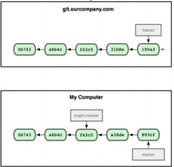
Remote tracking branches

Slide 48
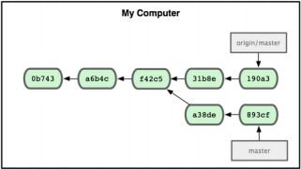
Remote tracking branches

Slide 49
In summary…
 Basic workflow in git
 Adding, committing, viewing diffs
 Branches
 The HEAD pointer, merging, and rebasing
 Remotes
 Pushing and fetching; quick introduction to Github

Slide 50
Lots of other topics
◻◻ Tags and version numbers
◻◻ Interactive rebase: squashing and amending commits
◻◻ Relative pointers from HEAD (e.g. HEAD^^, HEAD~3)
◻◻ Submodules
◻◻ Using your own server as a git server (bare repos)
◻◻ Git as a filesystem (git grep, git ls-files, etc.)
◻◻ GUIs to view trees and graphical merge tools
◻◻ …more!

Slide 51
For more information
◻◻ The book Pro Git (which I based much of this presentation on), available for free!
¤ https://github.s3.amazonaws.com/media/progit.en.pdf
¤ Covered Chapters 1-3 in detail, very simple ideas from Chapters 4-6
◻◻ Git documentation: do git help <commandname>
◻◻ Google, StackOverflow, etc.

Slide 52
That’s all for today!
◻◻ We’re done with client-side technologies!
◻◻ Office hours tonight, 7-9pm in 32-044 (basement of Stata)
◻◻ Tomorrow: 11am in 26-152 (8.01 teal room)
¤ Introduction to server-side technologies, SQL databases, UI/UX

